Slide 1

Ahsanullah University of Science & Technology Dept. of Computer Science & Engineering Spring 2021
presentation on the project report of Diabetes Prediction Based on Health Indicators
Pattern Recognition Lab CSE 4214 Group No. 5 Section B1

Slide 2




Presented by
Md. Sakib Irtiza 170204081
Abrar Rafid Noor 170204059
Labib Abdullah 170204114

Slide 3
Roadmap of the Presentation
Dataset & Preprocessing
Introduction
Experiments & Results
1
3
5
2
4
6
Literature Reviews
Methodology
Conclusion & Future Works

Slide 4
1.
Introduction

Slide 5
In This Project
We have tried to tackle a multi-class classification problem of predicting
No Diabetes
Prediabetes
Diabetes

Slide 6
2.
Literature Reviews

Slide 7
Building Risk Prediction Models for Type 2 Diabetes Using Machine Learning Techniques
Zidian Xie, PhD1,2; Olga Nikolayeva, MS2; Jiebo Luo, PhD3; Dongmei Li, PhD1 (View author affiliations)
Learned about BMI ranges and binned them in our preprocessing. We also learned important features that impact the most such as BMI, Age etc. SVM, Random Forest and Neural Networks performed the best.

Slide 8
Evaluating Machine Learning Methods for Predicting Diabetes among Female Patients in Bangladesh
Badiuzzaman Pranto , Sk. Maliha Mehnaz , Esha Bintee Mahid , Imran Mahmud Sadman , Ahsanur Rahman and Sifat Momen
Random Forest performed the best. The features do not match with our dataset. We acquired some preprocessing techniques such as using a heatmap to identify important features.

Slide 9
3.
Dataset & Preprocessing

Slide 10
Dataset Collection
Diabetes Health Indicators Dataset
has been made through survey responses to the CDC's BRFSS 2015
downloaded from Kaggle
https://www.kaggle.com/alexteboul/diabetes-health-indicators-dataset
Diabetes Health Indicators Datas

Slide 11
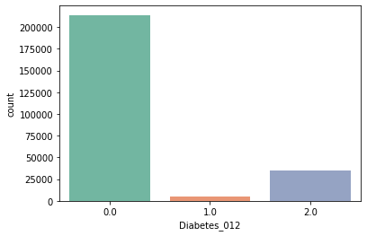
Data Distribution
Imbalanced

Slide 12
Random Sampling
NearMiss-3
NearMiss-1
Accuracy: 41%
Accuracy: 45%
Accuracy: 74%

Slide 13
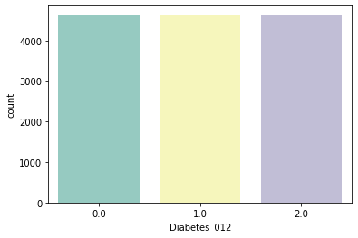
After Undersampling
balanced

Slide 14
Feature Selection

Slide 15
From Features Data Distribution
Veggies
HvyAlcoholConsump
DiffWalk
Stroke
HeartDiseaseorAttack
CholCheck
AnyHealthcare
NoDocbcCost
MentHlth
PhysHlthDatas

Slide 16
Features Data Distribution Results
Class | Precision | Recall | F1 Score
No Diabetes | 0.71 | 0.90 | 0.79
Prediabetes | 0.63 | 0.59 | 0.61
Diabetes | 0.65 | 0.54 | 0.59
Accuracy: 0.67

Slide 17
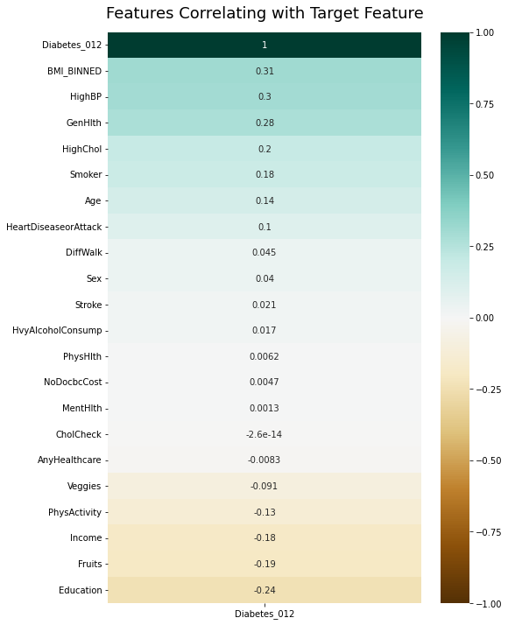
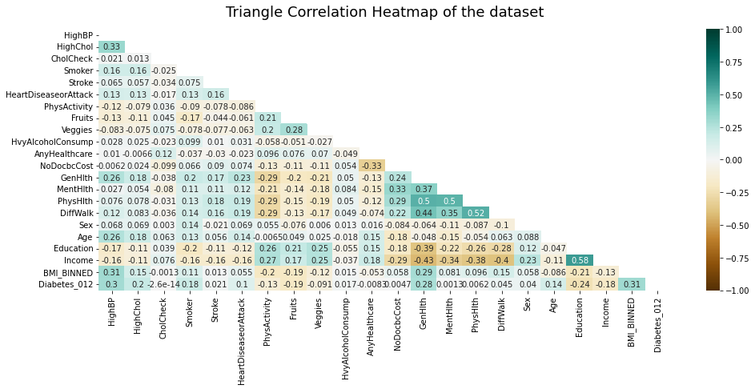
From Correlation Heatmap

Slide 18
From Correlation Heatmap
DiffWalk
Sex
Stroke
HvyAlcoholConsump
PhysHlth
NoDocbcCost
MentHlth
CholCheck
AnyHealthcare

Slide 19
Correlation Heatmap Results
Class | Precision | Recall | F1 Score
No Diabetes | 0.70 | 0.90 | 0.79
Prediabetes | 0.64 | 0.60 | 0.62
Diabetes | 0.64 | 0.51 | 0.57
Accuracy: 0.66

Slide 20
Implementing Chi Squared Test
HighChol
CholCheck
Stroke
PhysActivity
Fruits
Veggies
HvyAlcoholConsump
AnyHealthcare
Sex
Age
Education

Slide 21
Chi Squared Test Results
Class | Precision | Recall | F1 Score
No Diabetes | 0.67 | 0.81 | 0.73
Prediabetes | 0.87 | 0.68 | 0.76
Diabetes | 0.65 | 0.65 | 0.65
Accuracy: 0.71

Slide 22
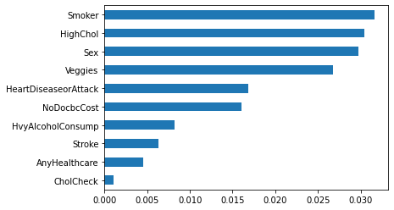
Implementing Extra Tree Classifier

Slide 23
Extra Tree Classifier Results
Class | Precision | Recall | F1 Score
No Diabetes | 0.68 | 0.86 | 0.76
Prediabetes | 0.77 | 0.71 | 0.74
Diabetes | 0.70 | 0.58 | 0.68
Accuracy: 0.71

Slide 24
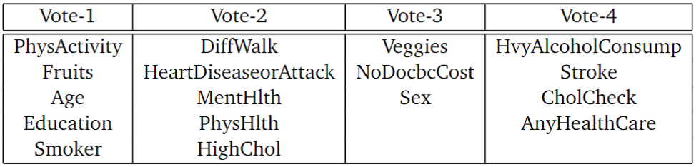
The Voting System

Slide 25
After Voting Results
Class | Precision | Recall | F1 Score
No Diabetes | 0.71 | 0.91 | 0.81
Prediabetes | 0.75 | 0.70 | 0.72
Diabetes | 0.76 | 0.62 | 0.68
Accuracy: 0.74

Slide 26
Feature Extraction

Slide 27
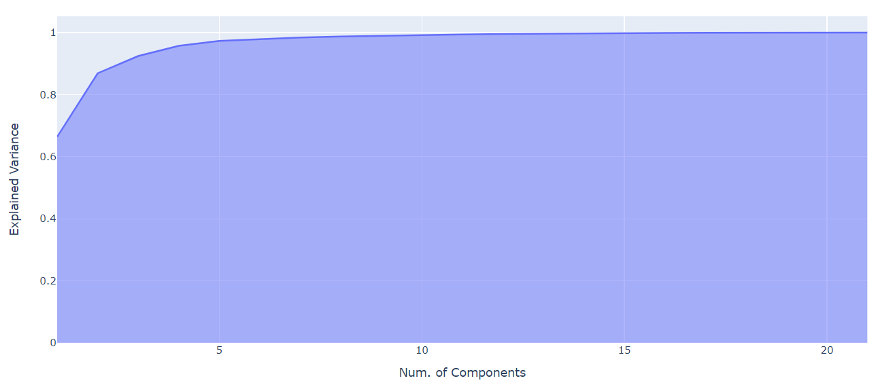
Principal Component Analysis
7

Slide 28
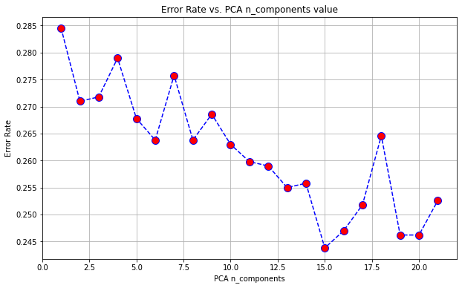
Principal Component Analysis

Slide 29
PCA: Number of Components
7
Accuracy: 0.72
15
Accuracy: 0.76

Slide 30
In the end
PCA with principal components = 15 gave the highest performance for the validation set.

Slide 31
4.
Methodology

Slide 32
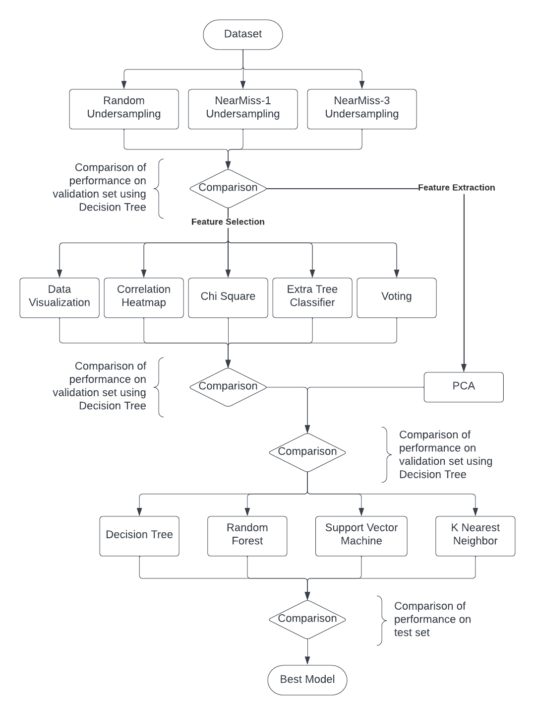
Flow Diagram

Slide 33
5.
Experiments & Results

Slide 34
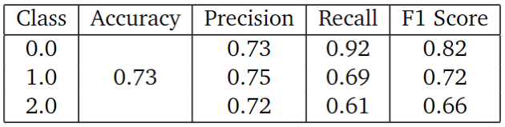
Decision Tree Results

Slide 35
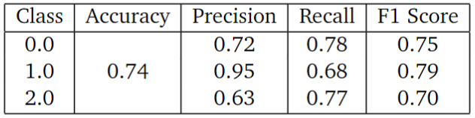
Support Vector Machine Results

Slide 36
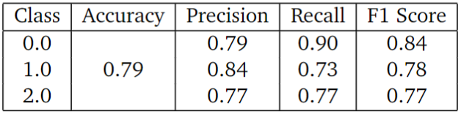
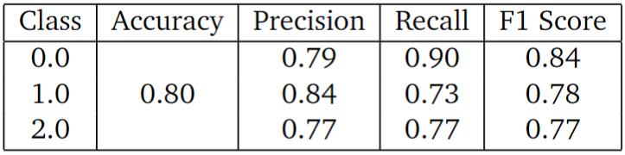
Random Forest Results

Slide 37
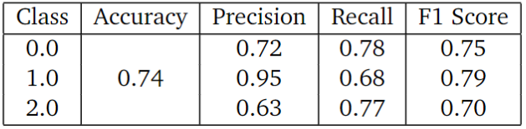
K Nearest Neighbor Results

Slide 38
6.
Conclusion & Future Works

Slide 39
Random Forest
With 80% accuracy

Slide 40
In the next we will
Train our dataset on Neural Networks
Training on our dataset and testing on local dataset

Slide 41
Thank You!

